Slide 1
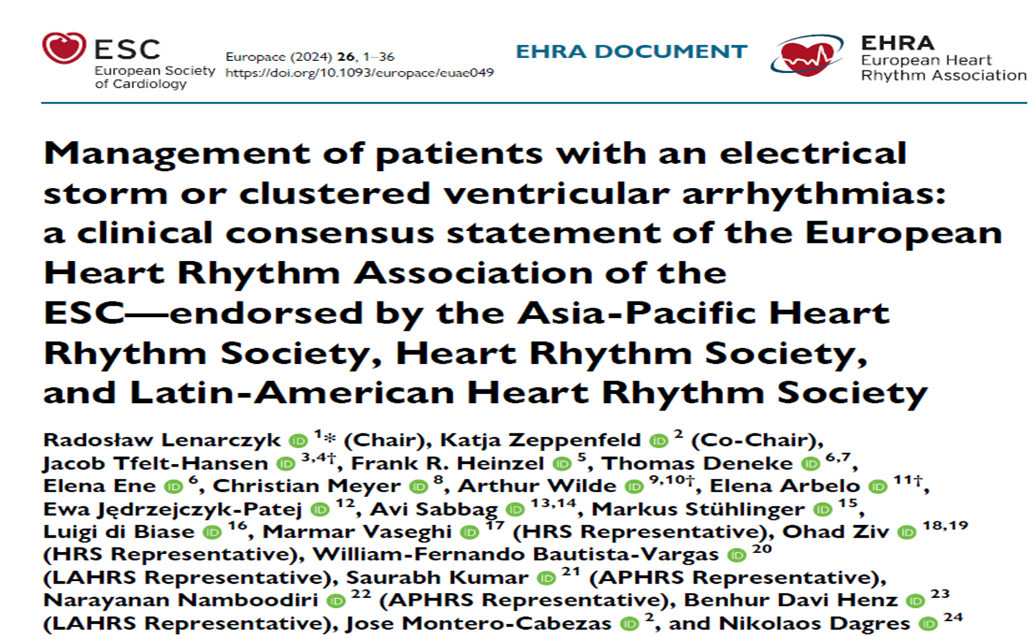
ADD TITLE
Add Subtitle

Slide 2
ventricular arrythmiA(VA)
DEFINITION OF SUBTYPES
Electrical Storm → > 3 sustained VA occurring within 24 hours, separated by 5 minutes, each requiring termination by an intervention
Clustered VAs → > 2 Sustained VA events within 3 months
Incessant VTs → Continous sustained VT that recur promptly despite repeated intervention for termination over several hours.
Notes:
Monomorphic VT—have underlying shd
Polymorphic VT- acute cardiac ischemia/channelopathies

Slide 3
Electrical storm with recurrent icd shocks
HEART FAILURE / CARDIAC INJURY
INCREASED MORTALITY
PSYCHOLOGICAL DISORDER

Slide 4
VT STORM
Incidence
Primary Prevention ICD → 4-7% ;
Average Time after device implantation 18-24 months
Secondary Prevention ICD → 10-30%
Average Time after device implantation
4-9 months
Notes:
THE INCIDENCE OF ES IS LOWER IN PATIENTS WHO UNDERGO ICD FOR PRIMARY PREVENTION

Slide 5
VT STORM
Incidence
Primary Prevention
Ischemic Cardiomyopathy = Non Ischemic Cardiomyopathy
ICD >> CRT-D →
1) Better improvement of LV function with CRT
ES in channelopathies – Scarce data
ICD shock in CPVT tend to increase further episode
Notes:
In some cases LV pacing was associated with es And they should be disabled.
Es is more common in patients with SHD and ICDs. Occasionaly they may be the first manifestation of previously not known cardiac disease.

Slide 6
Electrical storm
Morbidity and Mortality
Depends on
Chronic amiodarone use ( increases DFT )
CKD
EF<35% etc
Associated comorbidities etc.

Slide 7
Pathophysiological aspects
The vulnerable heart
Structural heart disease / Primary electrical disease
Precipitating factors
The autonomic nervous system

Slide 8
Structural Heart disease:
Vulnerable heart
cCAD patients:
More diseased LV segments ( Anterior, Septal and apical endocardial scar)
NICM → Lateral LV endocardial scar
VA substrate linked to Heterogenous fibrosis
Structural HD With ES more common in :
Older
Male
Advance Heart failure
Higher cardiovascular comorbidity
Associated renal failure
Notes:
1) Some studies have shown no difference in vt storm in awmi and Iwmi

Slide 9
Primary electrical disease
Vulnerable heart
TdP + deterioration into VF → Signature arrythmia In long QT
LQT1 → Triggered by exercise
B-Adrenergic stimulation →
IcaL activation < --- > Dysfunctional Iks channel
Prolonged APD(during exercise )
Sudden adrenergic surges like arousal does not induce this effect because of functioning Ikr
Notes:
Other arrythmic syndromes- pt may experience pvt or vf
LQTS- adrenergic stimulation exerts genotype specific effects.

Slide 10
LQT2 → Triggered by sudden arousal
Abrupt B-Adrenergic stimulation →
IcaL activation < --- > Dysfunctional Ikr channel
Prolonged APD (during sudden arousal)
More sustained adrenergic stimulation does not induce this effect because of functioning Iks

Slide 11
CPVT
Beta adrenergic stimulation
Increased calcium leak through the ryanodine receptor Type 2
Triggering delayed after depolarization and VA especially from Purkinje cells

Slide 12
1) Brugada syndrome
2) Early repolarization syndrome
Precipitating factor
1) Beta adrenergic blockade
2) Bradycardia
3) Vagal stimulation
4) Fever

Slide 13
BRUGADA SYNDROME
Epicardial to Endocardial repolarization gradient
Microstructural abnormalities of Extracellular matrix ( Fibrosis ) →RV subepicardial myocardium
Subepicardial conduction In RVOT can be further compromised by Impaired Na+ current/ Na+ channel blockade
Large potential difference relative to body
RV epicardial activation delay → J point / ST segment elevation → predispose to PVT and VF
Notes:
gradient was assumed as one of the underlying mechanism for arrythmia initiation
This suggest presence of subtle subepicardial cardiomyopathy rather than pure electrical disease.
Idiopathic VF, depolarization abn that allow for reentry and vf

Slide 14
External precipitating factors / triggers
Sr. Electrolytes (Na⁺, K⁺, Mg²⁺,Ca²⁺)
Fever → Brugada syndrome
Hypothermia → ERS
Harmonal factors( Hyperthyroidism , Hypothyroidism ) → Amiodarone induced Thyrotoxicosis
Ischemia
Beta adrenergic stimulation , Sepsis , Starvation, Decompensated heart failure.
Non compliance to medical therapy
Renal / Liver dysfunction → Precipitate drug toxicity
Toxicology screen → Cocaine , Alcohol , Aconite

Slide 15
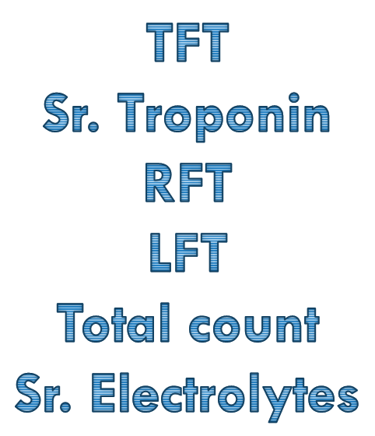
Initial screening
Notes:
echo

Slide 16
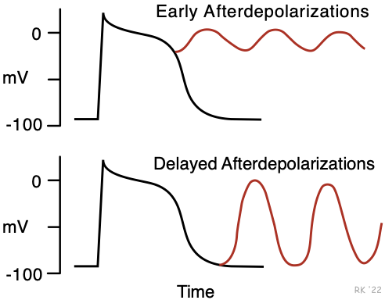
The autonomic nervous system
Denervation of sympathetic fibres in scar area
Subsequent localized nerve sprouting in border zone region
Loss of efferent sympathetic fibres in non infarcted areas
Regional super-sensitivity in scarred areas
Sympathetic and parasympathetic imbalance promotes arrythmia:
Shortening and creating heterogeneities of action potential duration
Increasing dispersion of repolarization
Promoting early and late after depolarisation

Slide 17
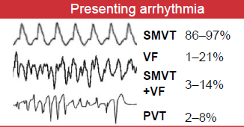
Clinical presentation
Palpitations
HR < ICD detection rate
VT terminated by ATP
VT terminated by Shocks
Unstable VT/VF requiring ACLS
Arrhythmic death
DEPENDS ON:
Underlying Cardiac disease
Biventricular function
Type and cycle length of VT
Time to Termination
Mode of Termination
Notes:
Va terminated by ATP are likely to improve earlier than patients with prolonged VT terminated by ICD shock after ATP failure.
In 50% the interval between VT/VS epidoses are less than 1 hour.

Slide 18
ELEVATED SYMPATHETIC TONE
ICD SHOCKS
Cardiac ischemia
Cardiogenic shock
Renal dysfunction
Electrolyte imbalance and Metabolic acidosis
VT storm

Slide 19
Acute management
Initial Hemodynamic and Vital assessment
History:
History of heart disease / sudden cardiac death in family
Recently up-titrated or initiated drug
Condition precipitating electrolyte abnormalities
ECG

Slide 20
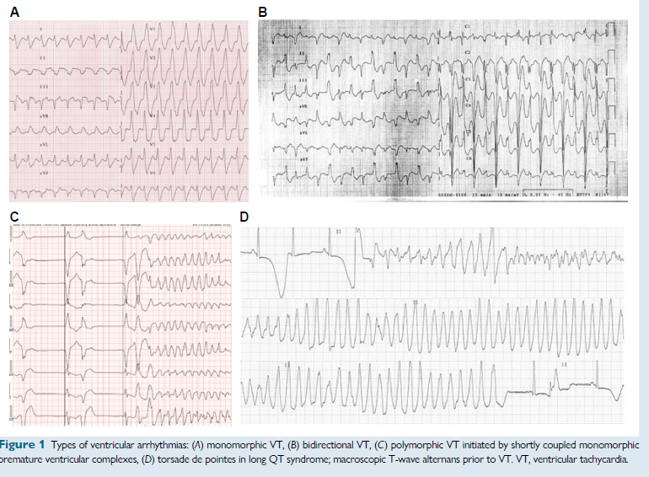
Notes:
BIDIRECTIONAL VT-Digoxin toxicity, Anderson tawil syndrome, cpvt , aconite poisoining

Slide 21
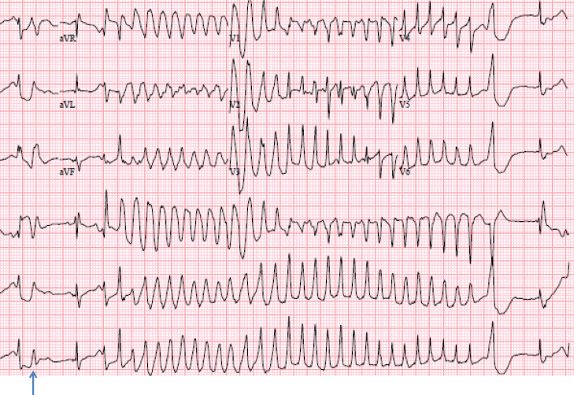
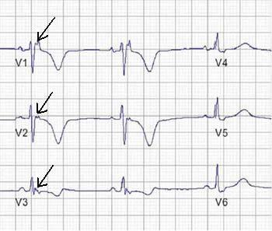
QRS fragmentation, Pathological q waves → cCAD
STEMI
QTc interval
Notes:
2)Polymorphic VT → acute ischemia, primary electrical disease like Brs, SQT, IVF,CPVT, ERS
3)epsilon waves.- arvc, sarcoidosis

Slide 22
cpvt
Electrocardiographic features ^{Braundwald}
35% → Bidirectional VT ;
Syncopal episode induced by exercise or emotion in a child
VAs → when sinus rate exceeds individual threshold rate ( usually at 110-130/min) – Exercise testing
Sometimes exercise provoked arrythmia can be demonstrated only after a delay of months or more after the first syncopal episode → need for repeat TMT if there is high suspicion
Notes:
ICD itself has an proarrythmic event because of catecholaminergic surge. Vf episodes are always terminated by ICD but not bidirectional VT and PVT

Slide 23
PVC OF CPVT VS HEALTHY CONTROLS DURING TMT
Larger number of PVC
First appearance at high workload
LBBB and inferior axis
Bigeminy or trigeminy at peak stress
QRS >120msec
Coupling interval > 400msec
Disappearance in first minute after recovery
Braunwald

Slide 24
Vt- lbbb like and inferior axis
ARVC AND IDOPATHIC VT FROM RVOT
50% of patients with ARVC can be normal at presentation
Abnormal myocardial substrate in VT in ARVC^{[Braunwald]}
QRS notching in atleast 2 leads
QRS duration in Lead 1 exceeding 120msec
Later precordial transistion (v5-v6)
Notes:
RBBB LIKE VT WITH LEFT SUPERIOR AXIS→ left fasicular vt, Papillary muscle vt and perimitral vt

Slide 25
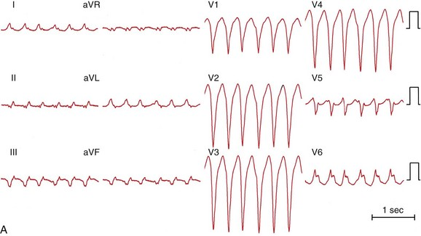
Notes:
Bbrt → patients with shd esp dcm.
Fast >200bpm, LBBB like VT, with rapid downstrokeof s in anterior precordial leads, QRS during sinus rhythm may be identical to qrs in VT. Qrs in sr is also broad. Shorter r wave peak time and fast downstroke of s wave in v1-v2

Slide 26
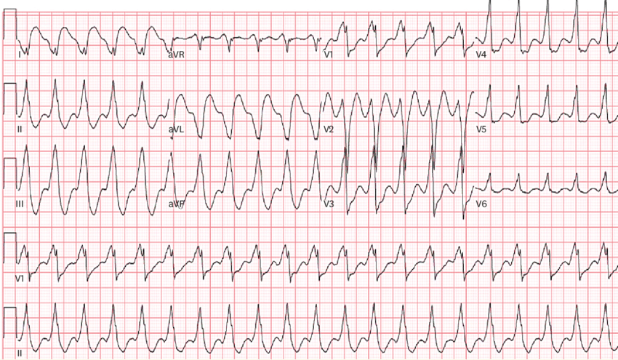
Notes:
Rbbb like vt with pseudo delta wave and broad rs interval with absence of q in inferior leads and presence in lead 1. pattern break- epicardial vt

Slide 27
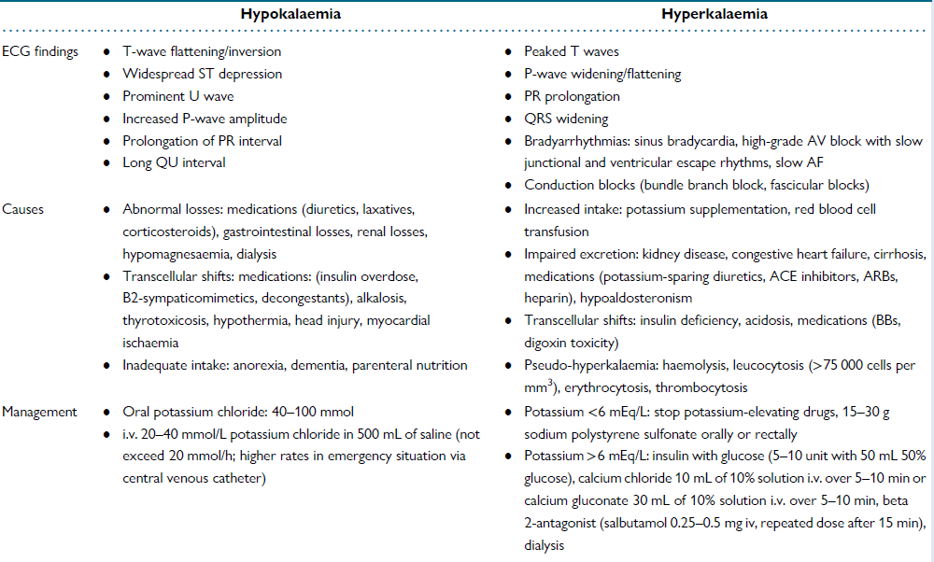

Slide 28
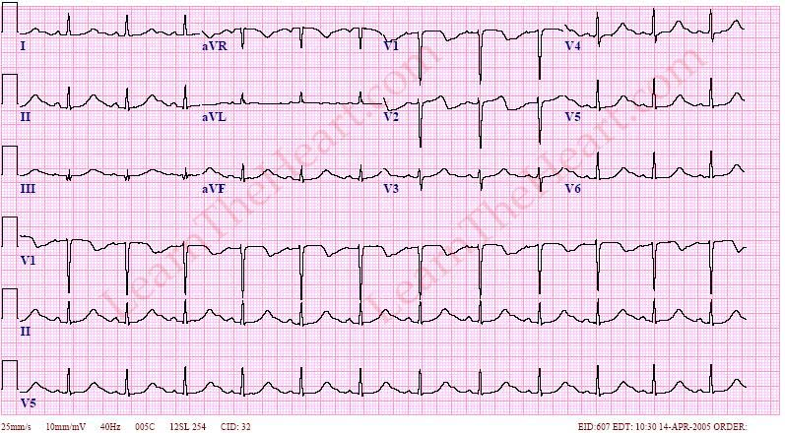
Notes:
QT prolongation because of ST prolongation

Slide 29
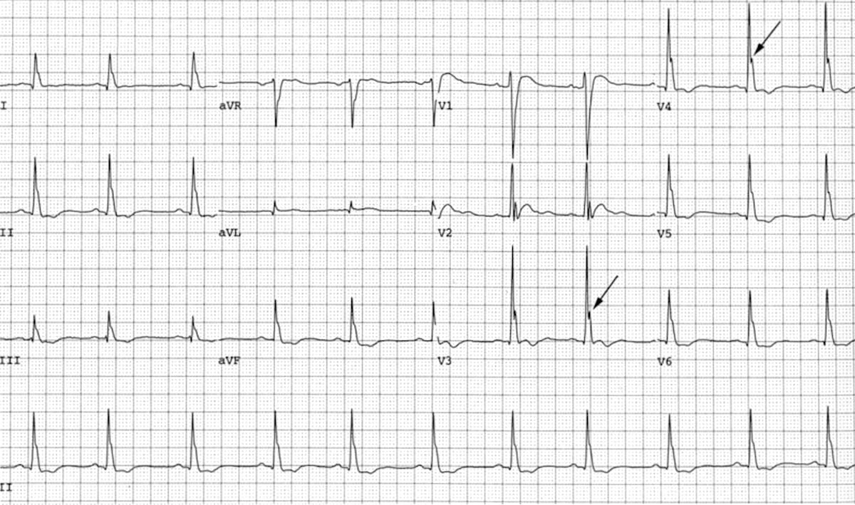
Notes:
Shortening of QT with Osborne waves

Slide 30
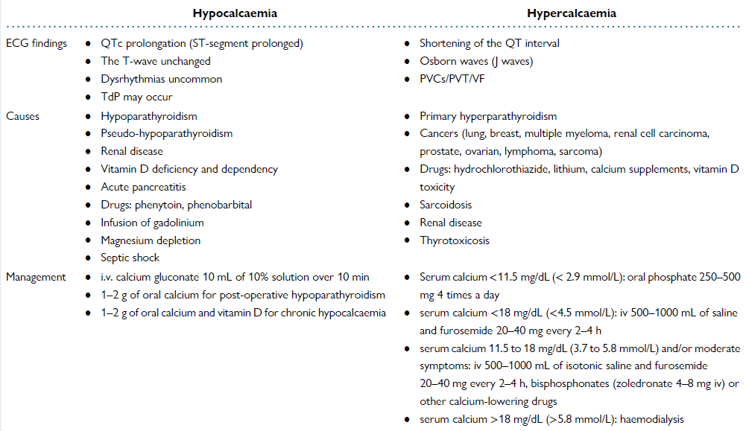

Slide 31
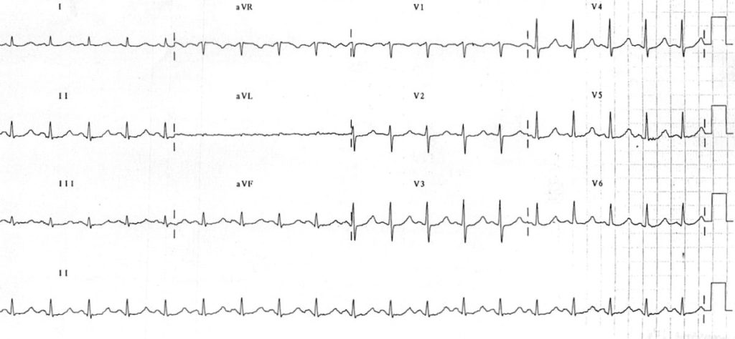
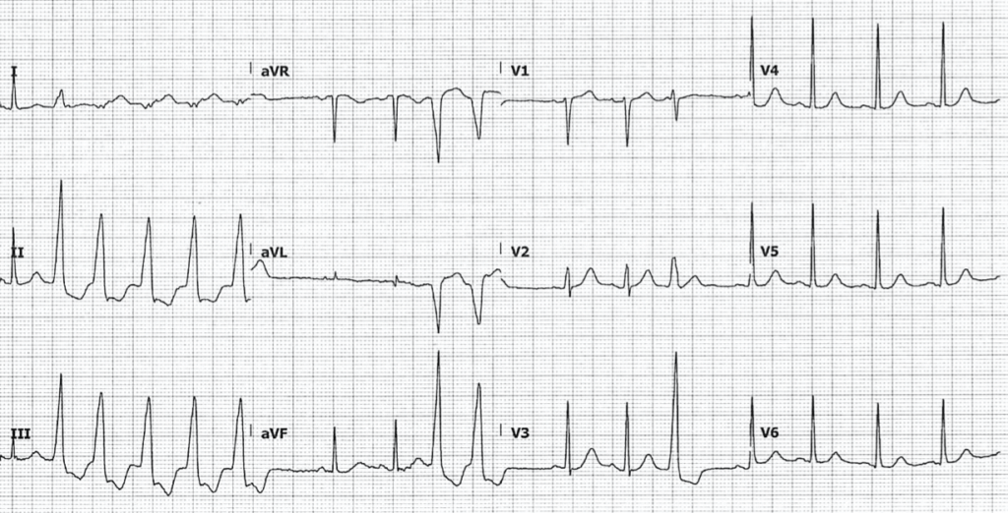
Notes:
Prolonged PR prolonged Qt
Ventricular ectopy → VT ; TDP
Hypomagnesemia

Slide 32
Notes:
Prolonged pr
Widenened qrs
Flat p and tall t wave

Slide 33
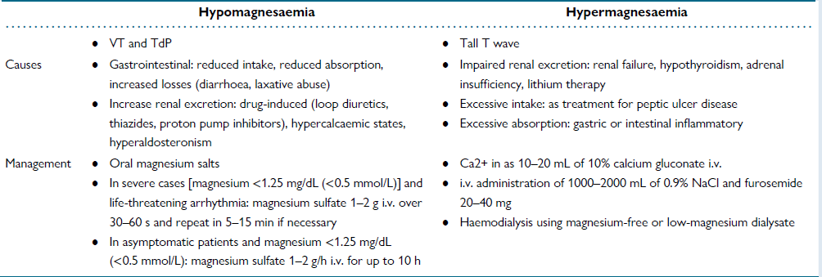

Slide 34
Documentation of VA and Immediate ICD interrogation
PVC Induced VF → 12 lead Holter to identify the morphology of VPC
Urgent CAG → Suspicious of ongoing Myocardial ischemia
Endomyocardial biopsy → Gaint cell myocarditis
FDG PET →Cardiac sarcoidosis or arrhythmic myocarditis when CMR is contraindicated due to ICD related artifact or diagnostic mismatch between EMB and CMR

Slide 35
Icd reprogramming
ICD SHOCK
Tachyarrhythmia
SVT
(Inappropriate detection )
VT/VF (Appropriate detection)
No Tachyarrhythmia
(over sensing)
1) Intra cardiac signal
2) Extra cardiac signal
3) Lead defect
Notes:
To rule out malfunctions- inappropriate icd shocks may mitigate vt/vf
Unnecessary ICD therapy may be triggered in non sustained VT. Particulary if short detection time is programmed. Such case of oversensing icd can be transiently disabled by placing a magnet on the device can.

Slide 36
? Inappropriate icd shock
Review 12 lead ECG e.g. Broad QRS with potential R wave double counting
Review ICD setting ( Detection and treatment)
Evaluate lead position and integrity if malfunction suspected i.e Chest x-ray
Review of all ICD episodes
Notes:
Ic drugs causing widening of QRS

Slide 37
Af/svt
TREAT ARRHYTHMIA
Rate and rhythm control
AAD/CA For AF
CA for SVT
Improve SVT/VT discrimination
Sudden onset
Chamber of onset
Interval stability
A vs V rate
Morphology
Notes:
1) Sudden changes in ventricular rate are more likely in VT while sinus tachycardia expected to have gradual rate increase
2) Determines whether a tachycardia initiates in the atrium with a short P–P interval or in the ventricle with a short R–R interval
3) Enables discrimination of AF from VT based on R–R interval regularity
4)Ventricular rate > atrial rate → VT is diagnosed
5) Analysis of QRS morphology in tachycardia to a reference QRS template in sinus rhythm to identify VT

Slide 38
Lead related over sensing
Conductor fracture
Insulation breach
Connection problems
Lead – lead interaction
Reduce oversensing : Enable specific algorithm
Reposition lead or implant new lead if indicated
Cardiac oversensing
Myopotentials from skeletal muscle
Electromagnetic interference
Reduce oversensing
Reprogram ventricular sensitivity
Enable specific algorithm
Alter sensing bandwidth
Reposition lead or implant if persistent oversensing

Slide 39
treatment
Electric storm with hemodynamic instability
Initiation of immediate ACLS

Slide 40
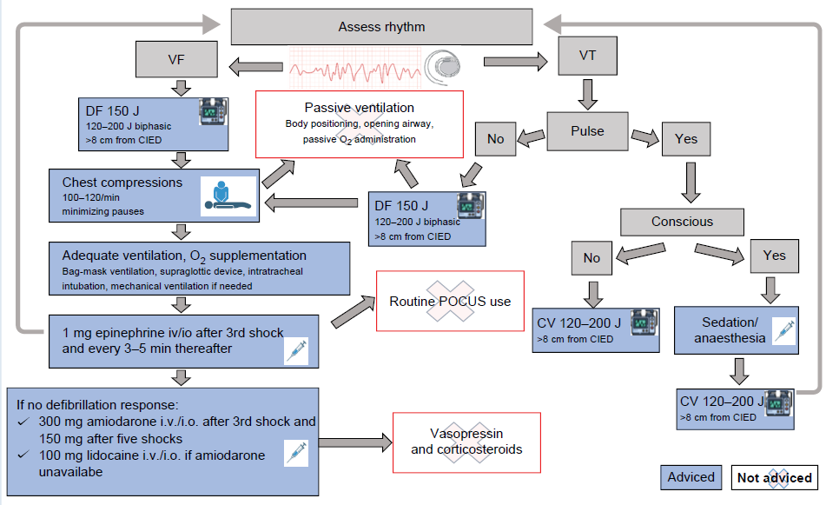
Notes:
Paddles should be placed at least 8cm from the ICD, if possible front and back position
Even in haemodyanamic tolerated VT, prompt termination with CV is preferred as haemodyanamic detoriation may occur

Slide 41
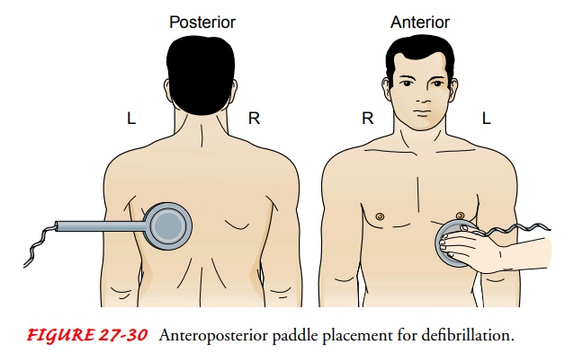
Notes:
Dccv front to back position is better.
Eccv is superior to icd shock for restoring sinus rhtym in af patients but data on vt/vf is lacking

Slide 42
Notes:
VC means initial anterior–lateral configuration delivered 3 shocks ; subsequent defibrillation attempts were delivered with defibrillation pads in an anterior–posterior configuration;
or DSED, defibrillation pads 2A and 2B are those of the second defibrillator, with the pads placed in the posterior and anterior positions. subsequent defibrillation attempts were performed with the use of two near-simultaneous defibrillation shocks provided by two defibrillators

Slide 43
outcomes
Both → showed Higher survival to hospital discharge.
Double sequential Defibrillation → Better neurological outcome

Slide 44
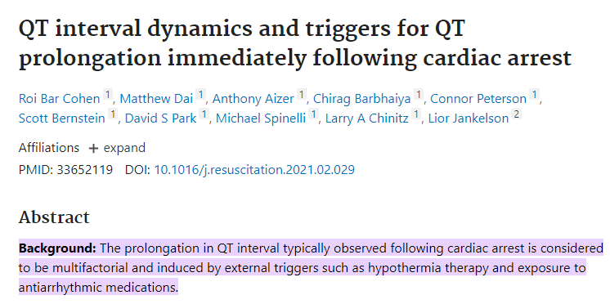
QTc or JTc interval → Prolonged post SCA, regardless of known QT prolonging triggers.
Normalization of the QTc post cardiac → After day 6 of hospitalization
Assessment of the QTc for idenfying the etiology of arrest or for monitoring the effect of QT prolonging medications may be unreliable in first 6 days.

Slide 45
Disease specific agents
Ongoing Myocardial ischemia → CAG
cCAD but no STEMI →CAG after Risk – Benefit assessment
MSVT → Rarely caused by Ischemia.
Gaint cell myocarditis → Immunosuppression
Myocarditis(autoimmune – no viral etiology) → Immunosuppression ( AAD & RFCA in drug refractory cases)
Cardiac sarcoid → ? Steroids / AAD or RFCA
TdP → I.v Mg²⁺ even in absence of Hypomagnesemia. I.v. K⁺ to target upper limits of normal range
Long QT → Potential offending drugs to be withdrawn except AADs used to treat ES.
Bradycardia prolongs QTc and may facilitate VA → Measures to Increase heart rate
Notes:
Monomorphic vT- ischemic evaluation without ACS did not improve mortality benefit after ablation

Slide 46
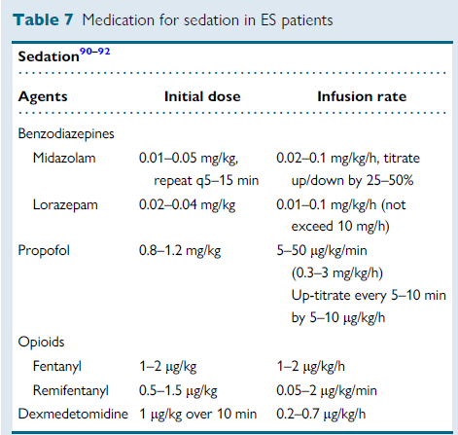
Deep sedation and mechanical ventilation
Have successfully controlled Drug refractory ES-Reduces sympathetic tone
First line
46 patients with VT storm, 15 were refractory to AAD.
12 had complete resolution of VT/VF( 1hour).
2 had partial resolution.(3 hours)
First line
Reduces sympathetic activity by acting on Alpha 2 receptors
Sedation and analgesia; no RD
Notes:
No negative inotropic effect
Opiods pharmacokinetics not affected by renal or liver failure

Slide 47
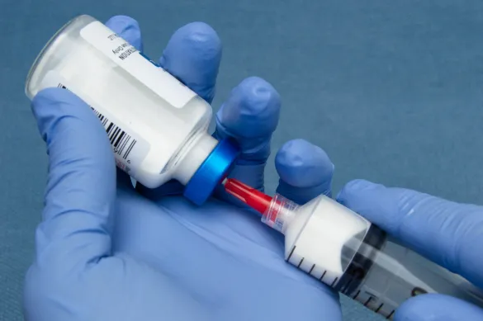
PROPOFOL
Increased Triglycerides
Pancreatitis
Allergic reactions
Infusion syndrome – Metabolic acidosis, Bradyarrythmia and renal failure , Rhabdomyolysis.
Prolong QTc
Inhibits sympathetic nerve activity
Cautious use in SHD because of negative inotropic effect; Hypotension

Slide 48
Pharmacotherapy for acute management of electrical storm
STRUCTURAL HEART DISEASE
SHD → I.V. Amiodarone and Oral propranolol
Recent MI < 3months → i.v. Esmolol or i.v. Propanolol or left stellage gangion blockade >> iv lidocaine
IV + Oral loading of Amiodarone shortens the time to VA control
SHD + Hemodynamically stable VT of unknown etiology → Procainamide useful ^{(PROCAMIO trial)}
Lidocaine → Acute ischemia
Ranolazine → reduce risk of VT/VF in pt requiring ICD therapy
Notes:
Iv amio+propranolol > metoprolol +amio
Lidocaine – 1mg/kg f/b 0.02mg/kg/min( negative inotropic effect. Caution in impaired lv function)
Ranolazine – inhibition of late sodium and delayed rectifier potassium channel

Slide 49
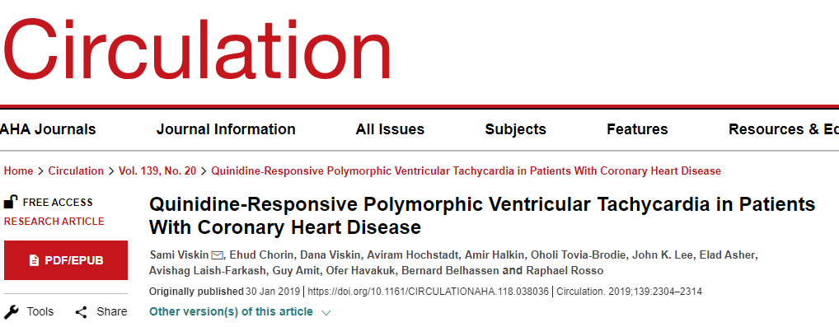
Polymorphic ventricular tachycardia + Absence of Ischemia
→ 3 to 8 days after a MI or Coronary revascularization intervention.
These arrhythmic events are triggered by short-coupled extrasystoles.
Arrhythmic storms are refractory to intravenous amiodarone
Highly responsive to quinidine therapy.
Notes:
Patients with coronary disease who develop polymorphic ventricular tachycardia are at high risk of developing arrhythmic storm.

Slide 50
Pharmacotherapy for acute management of electrical storm
PRIMARY ELECTRICAL DISEASE
LQTS → Remove triggers ; Non selective betablockers – Nodalol / Propanolol ; Iv magnesium/ Iv potassium; Mexilitine in LQT3 ;
Isoproternol in aLQTS
Temporary pacing in aLQTS and cLQTS2 ; Class iii avoided
BrS and IVF →iv isoproterenol + quinidine
Short QT → iv isoproterenol
CPVT → beta blockers ; Epinephrine avoided even in setting of cardiac arrest

Slide 51
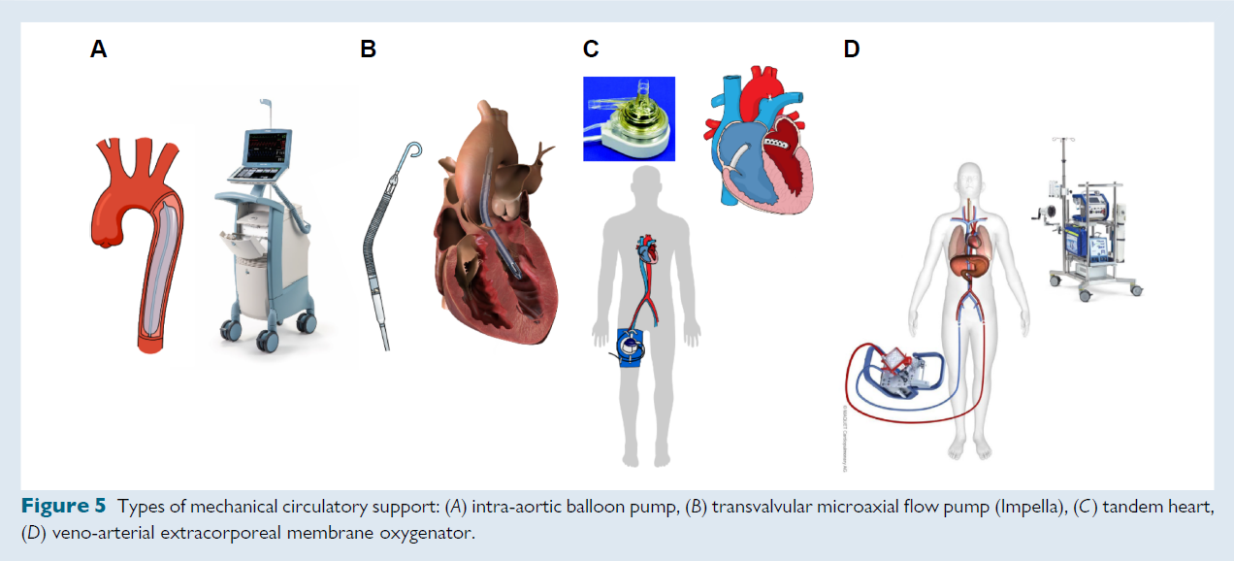
Mechanical circulatory support
Higher complication rates
Procedural logistics
Increased cost
? Role- Not extensively investigated
Notes:
Benificial by the way it can provide maintenance of organ perfusion while allowing for the treatment of VA.

Slide 52
Indications
Rescue therapy in acute Hemodynamic decompensation - ? Role
Rescue therapy in peri procedural Hemodynamic decompensation (During Ablation) – Rescue MCS higher mortality >> Elective MCS or No MCS
Prophylatic MCS prior to VT ablation in patients with risk of developing Hemodynamic instability.
In patients with high PAINESD score > 15 → MCS reduces mortality
Notes:
1) VA ecmo. One rct proved It was associated with lower mortality while other 2 rct showed no benefit. Systematic selection of optimal candidates and refinement of patient care remains the corner stone of successful therapy.

Slide 53
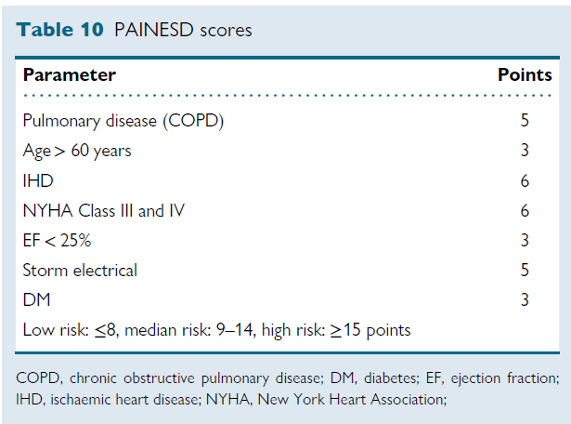

Slide 54
Acute catheter ablation
TOC in Monomorphic VT refractory to drug therapy in acute phase
It is advised in all eligible patients to reduce ES recurrence
Ideal Timing of Catheter Ablation ?
Rescue CA within first 24 hour with Shock → Higher ablation failure and recurrence
Catheter ablation after the first 48 hours from admission is associated with lower mortality compared to :
1) Conservative therapy or 2) Very early ablation
Notes:
So haemodynamic stabilization and arrythmia suppression should always be attempted before proceeding with CA but not always possible.

Slide 55
Catheter ablation
Electric Storm + PVT/VFs → Catheter ablation is challenging
Trigger elimination → Effective in post MI patients with focally triggered VF storms
Epicardial approach in refractory cases in NICM, cCAD .
Urgent Heart transplantation → VA storm refractory to therapy

Slide 56
Autonomic modulation
By sympathetic neuromodulation therapies
Elevated Sympathetic tone → Release of sympathetic cotransmitters ( Neuropeptide Y) → Decreases Action potential duration and influence arrhythmogenesis.
Stellate ganglion block
Thoracic epidural anaesthesia
Cardiac sympathetic denervation
Renal denervation
Notes:
Sympathetic activation extend beyond those influenced by BB therapy

Slide 57
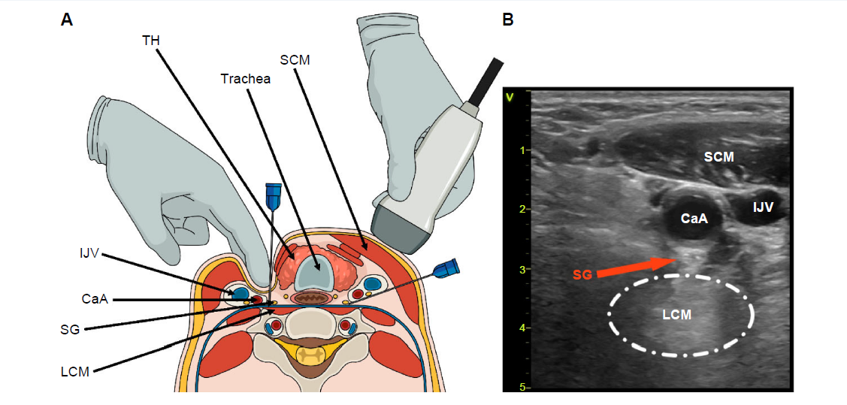
Stellate ganglion block
Bupivacaine or Ropivacaine at left or B/l Stellate ganglia
Notes:
. Continous infusion by catheter placement better option than single bolus dose,. Cryo induced or radiofrequency induced sgb are reported with success.

Slide 58
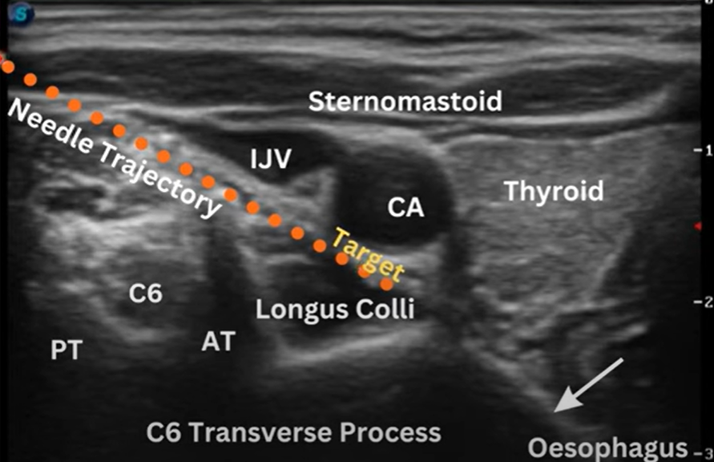
Notes:
C6 nerve root-… c7 absent AT, c5 has equal at and pt

Slide 59
Notes:
C6 nerve root-… c7 absent AT, c5 has equal at and pt

Slide 60
Thoracic epidural anaesthesia
C7-T4 epidural space
> 80% reduction in VT burden
Both are temporary measures used as a bridge to more definitive therapy
CONTRAINDICATION
Active infection
DAPT
Requirement of uninterrupted anticoagulation

Slide 61
Surgical or thoracoscopic cardiac denervation
Reduces burden of VT in LQTS and CPVT
Used in case of Beta blocker intolerance or refractoriness
In patients with structural heart disease, CSD may be efficacious in both Monomorphic VT, PVT or VF.

Slide 62
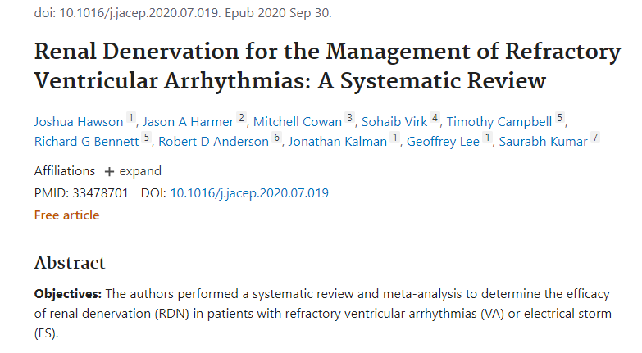
Renal denervation therapy
Ablation of renal nerve surrounding renal arteries
RDN + VT Ablation → Cardiomyopathy (i.e. DCM and Chagas disease)
Notes:
RDN is an effective treatment for refractory VAs and ES, although randomized data are lacking.

Slide 63
Over drive pacing(ODP)
It extinguish the abnormal ventricular automaticity by overriding the ectopic pacemaker
It may cause exit block of the ectopic focus.
ODP can be done by :
ICD
Implanted pacemaker
TPI
Pace at rate 10-20 bpm greater than native tissue
Decremental ODP >> Fixed OD Burst pacing
Auto decremental pacing- 10msec superior to 5msec decrement
Notes:
Decremental ODP – progressive shorter interstimuli interval
Overdrive burst pacing- constant intervals
Similarly brady pacing useful in Brady mediated PVT

Slide 64
Bail out stratergies
Common cause of Cather ablation failure : Inability to create transmural or deep intramural lesion in ventricular myocardium
One solution is sequential radiofrequency applications from the adjacent opposite sites, i.e epicardial access
Other strategies:
Septal coronary venous mapping
Ethanol ablation
Stereotactic radiotherapy etc.
Bipolar ablation
Not done in large scales → done by highly skilled operators working in high volume centre

Slide 65
Stabilized patients
Long term treatment
Optimization of heart failure drugs
cCAD → Complete revascularization beneficial
Avoid precipitating factors → Like Pro-arrhythmogenic drugs , Alcohols, dyselectrolemia

Slide 66
Stabilized patients
Anti arrhythmic drugs in SHD
Beta blockers – Corner stone of Treatment
Beta blockers + Amiodarone → Reduce VA recurrence and shock; care to be taken of Amio-related side-effects
Some RCTs have shown Amiodarone at discharge was associated with increased mortality
Whether it is directly related to amiodarone or amiodarone is a marker for sicker patients is not clear.

Slide 67
Sotalol
Lower dose - Beta blocker ; Higher dose – Class III effect
Negative inotropic effect
QTc prolongation - TdP
Optic trial – Sotalol >> Betablocker in reducing the risk of ICD shocks
Mexiletine
High Bioavailability – oral administration
Blocks rapid sodium channels
Adjunctive to amiodarone to prevent VA in Amiodarone inefficacy or intolerable Side effects
Rapid loading →Precipitate Heart failure decompensation in Severe LV Dysfunction
Increases DF threshold
Notes:
Mexiltine - Useful in patients with arvc
Sotalol
Mixture of 2 isomers
d-isomer -- blocks K⁺ channel
l-isomer -- non selective Beta blocker with class 3 properties

Slide 68
Procainamide
Quinidine
Flecainide
Class IA AAD
Reduced ICD therapies in patients with VT refractory to other AADs
S.E., Drug Induced Lupus
Suppressing PVC induced PVT and VF in sub acute phases of MI ( but also after revascularization: CABG and PCI ) and in pts without SHD.
Flecainide + Betablocker/ Sotalol → used in ARVC VT refractory to single AAD or ablation
Not used in structural heart disease
Caution in patients with ARVC due to Myocardial depression and Rt heart (and left) failure.

Slide 69
CHRONIC PHARMACOTHERAPY
PRIMARY ELECTRICAL DISEASE
Beta blockers in LQTS – Non selective agents ( Nadolol , Propranolol)
Mexilitine or Ranolazine → LQTS3
BrS → Quinidine ( starting dose- 250-300mg bid)
CPVT → BBs + Flecainide → LCSD
ERS and IVF → quinidine
Notes:
Mexilitine in other lqts also.
Hydroxyquinine- 68% GI side effect

Slide 70
Catheter ablation
Ischemic heart disease
NICM
Stable patients + CM + on chronic amiodarone therapy → with ES , CA is advised.
In patients without chronic amiodarone therapy
CA , may be dependent on patients characteristics, comorbidities and preference
Outcomes for CA poor in patients with HCM, VHD, CS-active and Inherited DCM.
More complex VA substrate (eg. More intramural, epicardial,septal) as well as disease progression.
Notes:
Epicardial vs endocardial ablation strategy
Epicardial- endocardial ablation stratergy – Chagas , ARVC etc.

Slide 71
Catheter ablation
Primary electrical disease
Not first line option
BrS – epicardial RVOT substrate ablation – High success rate - Need further research
LQTS – 2 Studies –
1) Ectopy from ramifications of Anterior and posterior fascicle
2) RV epicardial abnormalities.
Eliminating these electrical activites successfully prevented arrythmia in 1 year follow up
CPVT - ? Purkinje fibre related origin of ectopy
Drug resistant ERS and IVF, in whom similar PVC trigger VF, CA is useful .

Slide 72
Special groups
Patient with advance heart failure
Optimization of HF treatment
LVAD and Heart transplantation
Amiodarone and Mexilitine in selected cases
Catheter ablation ( if substrate based approach is used) and recurrent VT induction is avoided
Notes:
Acute decompensation during vt induction

Slide 73
When not to perform intervention treatment
Terminally ill patients or advanced cardiac disease,
Holistic approach and options of ICD deactivation
Notes:
To relieve distress and provide patient comfort

Slide 74
THANK YOU

